Slide 1
4th Year Career Planning OBGYN
October 10, 2023
Jeannette Lager, MD, MPH
Naomi Stotland, MD
Kristin Olson

Slide 2
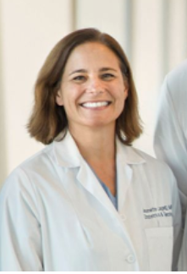
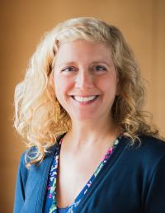
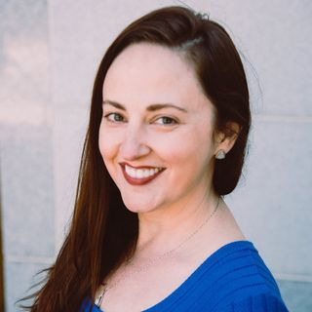
OBGYN MedEd
Jeannette Lager, MD, MPH
Medical Education Program
Director
Naomi Stotland, MD
Medical Education Program
Associate Director
Kristin Olson
Medical Education Team Manager
Notes:
Let the students know who we are and our sites. That we are here as a resource.
Please remind them that Vasilis Tabakis is our coordinator and that he keeps us all on track and everything going. Please be responsive to his emails.

Slide 3
October 2023—where are you now?

Slide 4
End of MS3 Year, final months of Foundations 2
Ensure all clerkships are Passed, no Incompletes (or completing soon)
Career Explore
Jan-Mar 2024 Step 1 Study and Complete
Gap Year Considerations
Deep Explore
Notes:
Clinical Clerkships
Pass/fail!
Use these as an opportunity to explore specialties and make connections
Step 1
Step 1 is pass/fail!
Step 2CK will matter more with subsequent application cycles
6 - 8 weeks of dedicated study time
ARCH Week will cover study resources and tips
Planning for a Gap Year
Gap years are not required to be a competitive OBGYN candidate, but some students take them for various reasons:
Professional - interest in research, seeking a dual degree, longitudinal community/advocacy work, etc.
Personal - burn-out, family reasons, other personal reasons
Starting for your gap year during the end of third-year by reaching out to potential mentors / applying to any dual degree programs
Also, make sure you are prepared to apply to residency/seek backup funding in the event that your project is not funded by the inquiry office (this happens every year and can be stressful!)
Before leaving for your gap year, consider:
1) Completing 1-2 Sub-Is (while your clinical skills are still sharp)
2) Taking Step 2CK (while your Step 1 and shelf exam knowledge is fresh)
Career Launch/DCR
4-week block in March after finishing Step 1
Some students are still studying during this block and take Step 1 at some point during the 4 weeks
Two functions of this block:
1) Learn about the roles and responsibilities of a sub-I
2) Work on your inquiry funding proposal for Deep Explore (even if you aren’t applying for funding)
Deep Explore
12-20 weeks during your 4th year on a project
About 1/3 of the class takes a year off for a more extended research project or additional schooling
Can continue previous projects or look for new mentors and projects
See prior sections for where to find OB/GYN research!

Slide 5
Match 2025
OBGYN moving off the AAMC Portal (ERAS) to an independent one
More info to follow at April 2024 workgroup meeting
If double-applying, one specialty is ERAS, OBGYN new portal

Slide 6
2025 Match Calendar

Slide 7
MS4 Year
Sub-Internship, complete by 8/30/24
Advanced Gynecology (ZSFG or Mission Bay/Mount Zion)
High-Risk Obstetrics (ZSFG or Mission Bay)
Gynecologic Oncology at Mission Bay/Mount Zion
Electives, take between April-September 2024
Intro to Family Planning - ZSFG (2 weeks, application required)
Intro to Reproduction Endocrinology & Infertility - MB (2 weeks)
Intro to Maternal-Fetal Medicine - MB (2 weeks)
Family Planning - ZSFG (4 weeks, application required)
Intro to Gyn Onc - MB (2 weeks)
Notes:
Sub Internship
Students will complete 1 OB/Gyn sub-I (4 weeks) before applying
Goals: opportunity to meet attending, get letters of recommendation, explore sub-specialties within OB/Gyn, expand on your skills, and learn about the UCSF residency program
Scheduling tips:
Do not schedule too many back-to-back sub-i’s!
Generally unnecessary to do more than 1 OB/Gyn unless you did poorly on one (also to be considerate to other students who also need to get their Sub-I’s done before applications!)
Scheduled between April - August before ERAS
Some students like to do a “warm-up” Sub-I or elective before jumping into their OB/Gyn Sub-I (i.e. Breast Surgery Sub-I, OB/Gyn electives, etc.)
Options for OB/Gyn Sub Internships and Electives:
Kristin Olson will send an email about the available options around the time of scheduling
Acting Internships:
Advanced Gynecology (ZSFG or Mission Bay/Mount Zion)
High-Risk Obstetrics (ZSFG or Mission Bay)
Gynecologic Oncology at Mission Bay/Mount Zion
Electives
Family Planning - ZSFG (4 weeks, application required)
Intro to Gyn Onc - MB (2 weeks)
Intro to Family Planning - ZSFG (2 weeks, application required)
Intro to Reproduction Endocrinology & Infertility - MB (2 weeks)
Intro to Maternal-Fetal Medicine - MB (2 weeks)

Slide 8
In addition during MS4 Year
CODA
Additional Research
MedEd projects, teaching opportunities
April 2024 will be a Match workgroup for all considering—details to follow
Get involved!
Near Peer Mentorship

